Slide 1
TIC2601 Database & Web Applications Project
Team 1:
Clifton Kor Way Feng​
Denny Wongso​
Muhammad Naufal Dusan Urosevic ​
Toh Jian Feng, Clarence ​
Yeoh Amy

Slide 2
What is Roofy?
Roofy is a top-notch Singapore Property Site that aims to help potential homeowners and tenants find their dream homes.
Dubbed as Property Guru v2.0
Our Target Users are:
Sellers
Potential Homeowners and Tenants
Property Agents

Slide 3
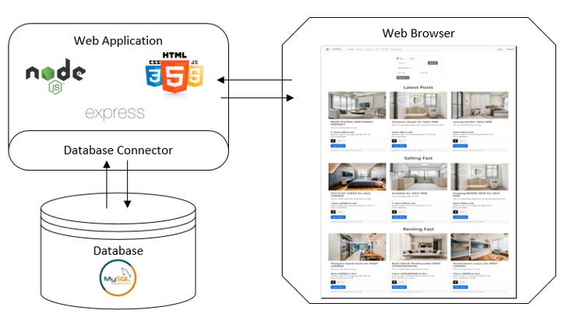
Key Technologies Implemented
We have implemented a wide-range of technologies into our site to allow for better accessibility and useability. Technologies used are as listed below:
HDB API
Google Maps API
Facebook API
Bootstrap for Styling
Carousel Bootstrap JS
Moments for Date Format
EJS (Embed Javascripts)

Slide 4
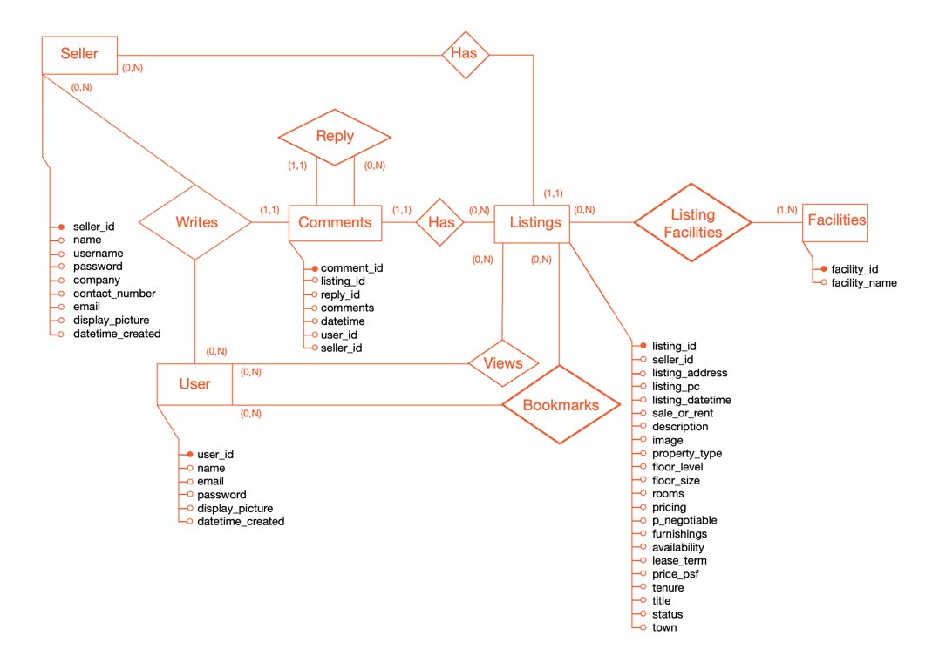
Entity Relationship Diagram

Slide 5
Hurdles Faced
While Developing Roofy, some of the hurdles faced were:
Postal Codes of Buildings currently being built and couldn’t be found on Google Maps ( E.g BTOs)
Postal Codes beginning with ‘0’s
Difficulty in Storing Multiple Images into a single row in the Database

Slide 6
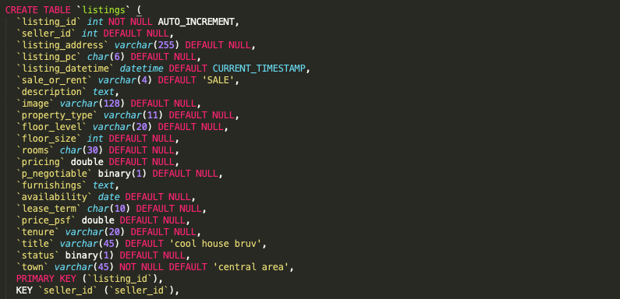
Complex Tables - Listings

Slide 7
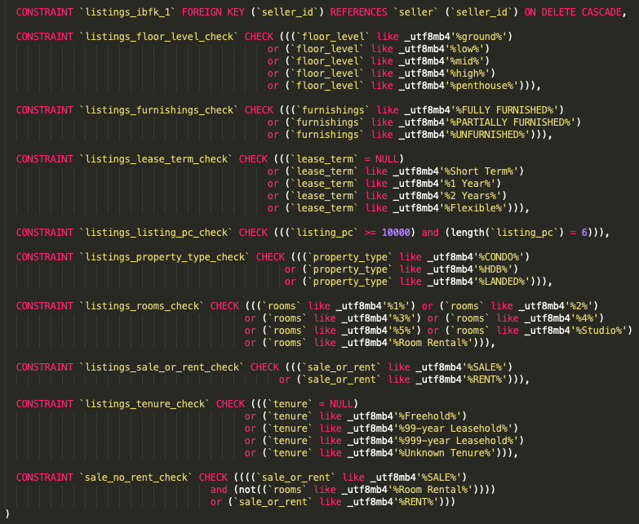
Complex Tables - Listings

Slide 8
Data Quality Checks
We Implemented various constraints into our tables to help enhance the quality of data collected from users of our site. The following are some of the constraints used:
’sale_no_rent_check’
‘listing_pc_check’
CONSTRAINT `comments_ibfk_5` FOREIGN KEY (`reply_id`) REFERENCES `comments` (`comment_id`) ON DELETE CASCADE

Slide 9
Features
Search Features
User & Seller Accounts
Bookmark Feature
Listing Features:
Listing Creation
Listing Update
Listing Deletion
Comment Feature
HDB Recent Transactions
Site Statistics

Slide 10
TIME TO GET ROOFYED!
A Live Demonstration
Disclaimer: Nobody will be roofied during the presentation. Maybe after? Who knows? Not us? Want to know more? Clifton's your man for all your roofy needs. Call him now @ 9222 8002.

Slide 11
Q & A Time!

Slide 12
Thank You!
PS: Prof, in case youre wondering, we are dead serious about getting our As.

